Slide 1


P-2024
Medi-Secure
Muhammad Hamza Siddiqui (Team Lead)
Shaheryar Nasir
Muhammad Saad Amin
Muhammad Ahmed
Supervisor Sir Ayoub Kamal
Co-Supervisor Dr Huma Jamshed
DHA Suffa University

Slide 2

Summary
Problem Statement
Business Objectives
Project Scope
Project methodology
Project Schedule (Time lines)
Budget / Costing (if any)
Project tools (or H/W required)
FYP Deliverables
References

Slide 3

Group Introduction
Mention name of students here
Muhammad Hamza Siddiqui cs201083
Muhammad Saad Amin cs201091
Shaheryar Nasir cs201093
Muhammad Ahmed cs201065
Your supervisor name here : Sir Ayuob Kamal
We chose Sir Ayuob Kamal as our supervisor because of his profound expertise in network and blockchain technologies. His strong grip on these domains is pivotal for guiding and supporting our project. Additionally, Sir Ayuob’s extensive knowledge in these areas provides a valuable resource for navigating the complexities of our work

Slide 4

1- Problem Statement
The pharmaceutical industry faces a rising threat of counterfeit medicines, particularly during events like COVID-19, posing a significant danger to public health.
Illegal actions in the pharmaceutical supply chain drive up medicine prices, straining finances for consumers and healthcare systems due to a lack of transparent distribution

Slide 5
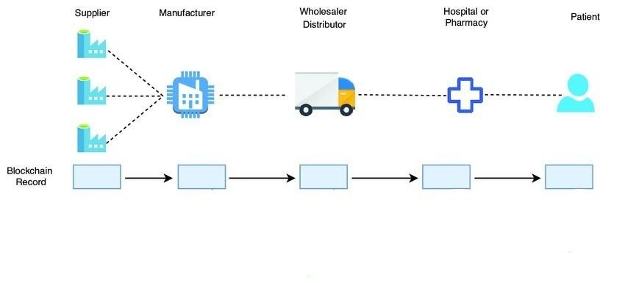
2- Business Objectives
Bridging the gap in trust and transparency within the pharmaceutical supply chain.
Disrupt black market practices and prevent the circulation of counterfeit medicines.
Implement blockchain technology to automate and secure transactions from production to pharmacist to avoid inflation in medical sector .

Slide 6
3- Project Scope
In Scope
Establishing a secure and automated transaction system through blockchain technology to ensure traceability and security, spanning from the production phase to pharmacists.
Developing a user-friendly web and app interface for seamless communication among pharmaceutical stakeholders, enhancing transparency and security in the medicine supply chain.
Out Scope
No medical treatment; emphasizes secure transactions, transparency in pharmaceuticals.
Detecting non-pharmaceutical health issues; focus is on pharmaceuticals.
Providing emergency medical services; the project's primary focus is on pharmaceutical supply chain enhancements

Slide 7
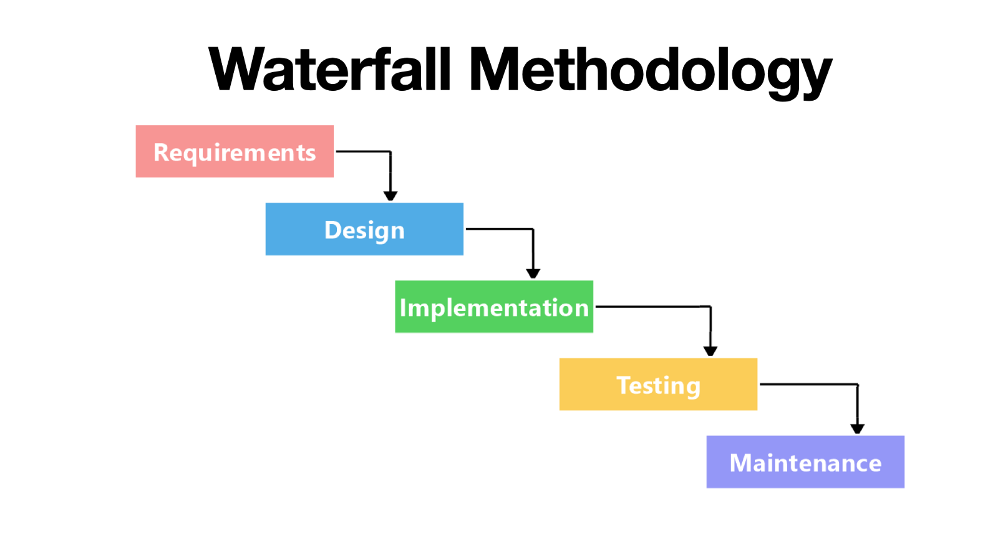
3- Project Methodology
Project Approach (Waterfall/Agile )

Slide 8
4- Project Schedule
Name | Role | Responsibilities
Muhammad Hamza Siddiqui | Team Leader | Back end development, Front end development , Block chain side
Muhammad Saad Amin | Team Member | Mobile App development, Front end development, Back end development
Shaheryar Nasir | Team Member | Mobile App development, Front end development, Back end development
Muhammad Ahmed | Team Member | Project Management, Front end development , Testing

Slide 9
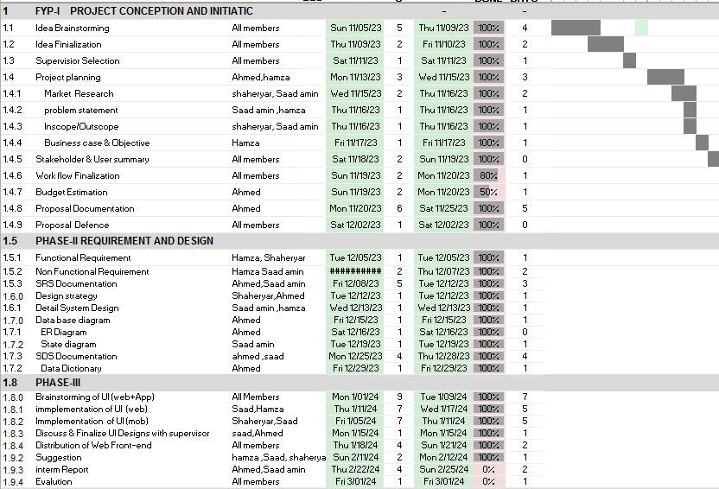
4- Project Schedule
Gantt Chart:

Slide 10


5- Project tools (or Hardware required)
List any tool required
React JS/NEXT
Node JS
Ethereum /Solidity
React Native
Hardware requirements:
Laptop
Mobile
Wi-Fi

Slide 11

6- Budget / Costing
Mention the budgeting cost of each item (if any)
Total Hours - 300 hrs.
Per Hour Rate - 500 Rs
Total Hours Rate –150,000Rs
Other resources – 50,000 Rs
Total cost Rs. 200,000 Rs

Slide 12
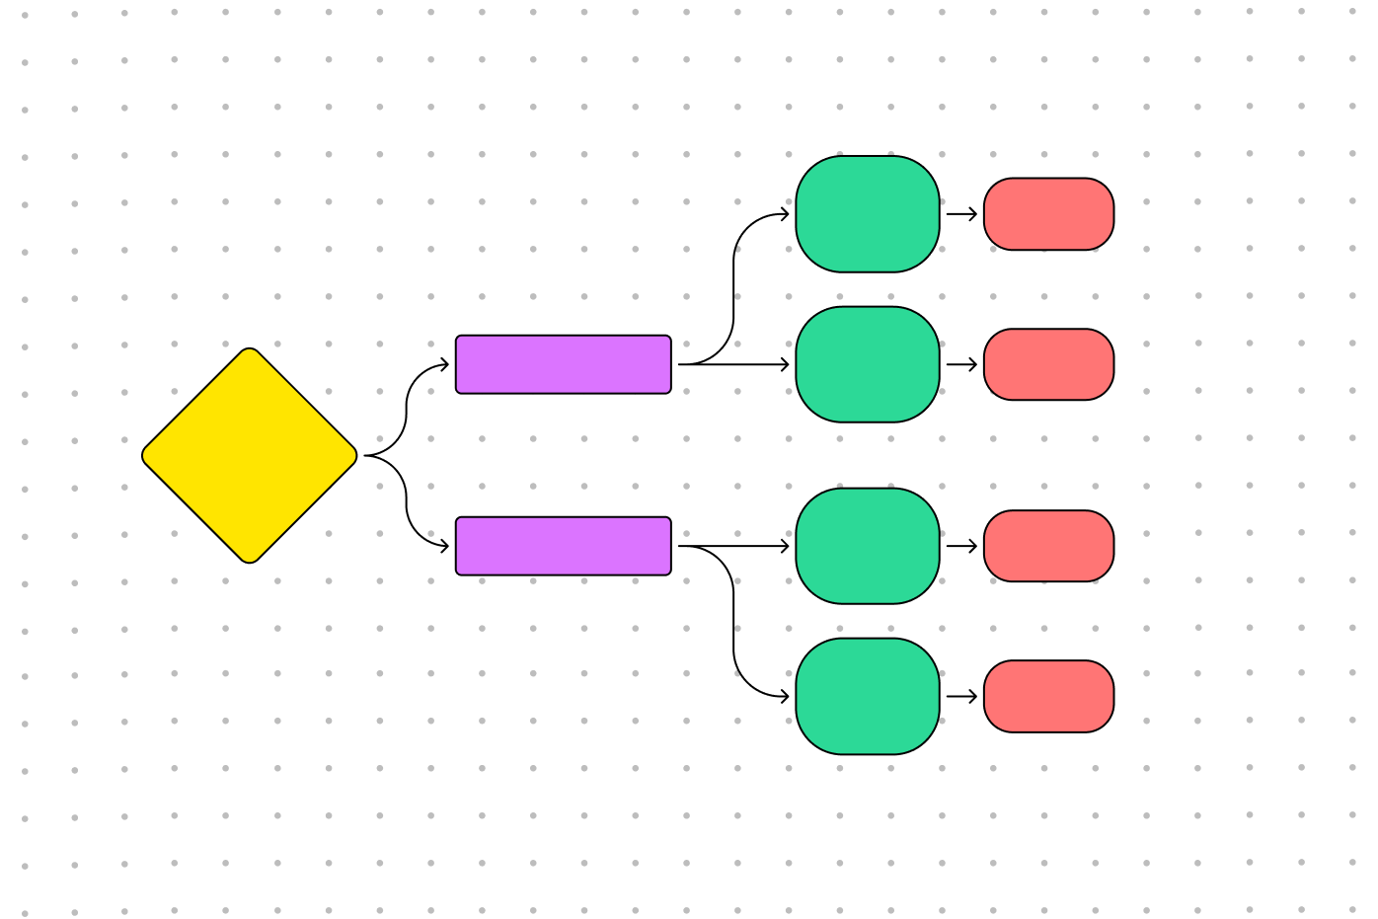
7- FYP Deliverables
Mention the project deliverables such as
Requirements documentation
Design Documents ( ERD, State Diagram, Use Case Diagram, Flow chart)
Running software application

Slide 13
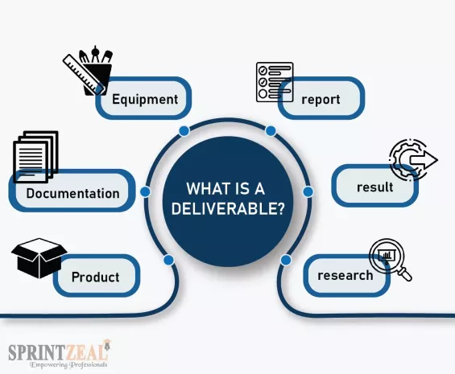
7- FYP Deliverables
Mention the project deliverables such as
Phase I - Alpha Prototype
Generating and refining ideas through collaborative brainstorming sessions
Formal Proposal Preparation
Market Research
Technology Stack Exploration
Documentation
Budget Estimation
UI design
Phase II - Beta Prototype
User implementation of block chain based web app and mobile app
40% of web app development
30% of mobile app development

Slide 14

7- FYP Deliverables
Mention the project deliverables such as
Phase III - Release Candidate
Block chain development
60% of remaining web app development
70% of remaining mobile app development
Phase IV - Final Product
Complete application
Testing
Final report

Slide 15
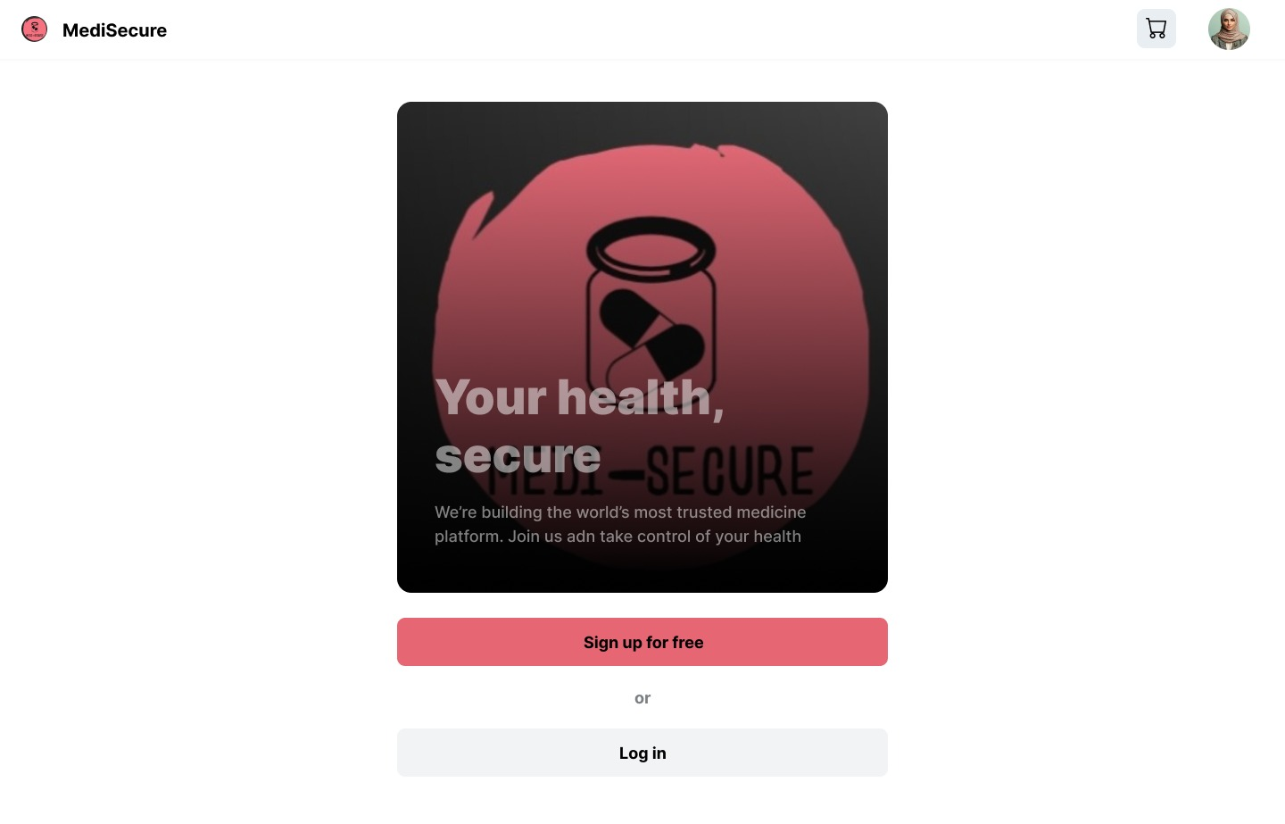
User Interface
Website User Interface:

Slide 16
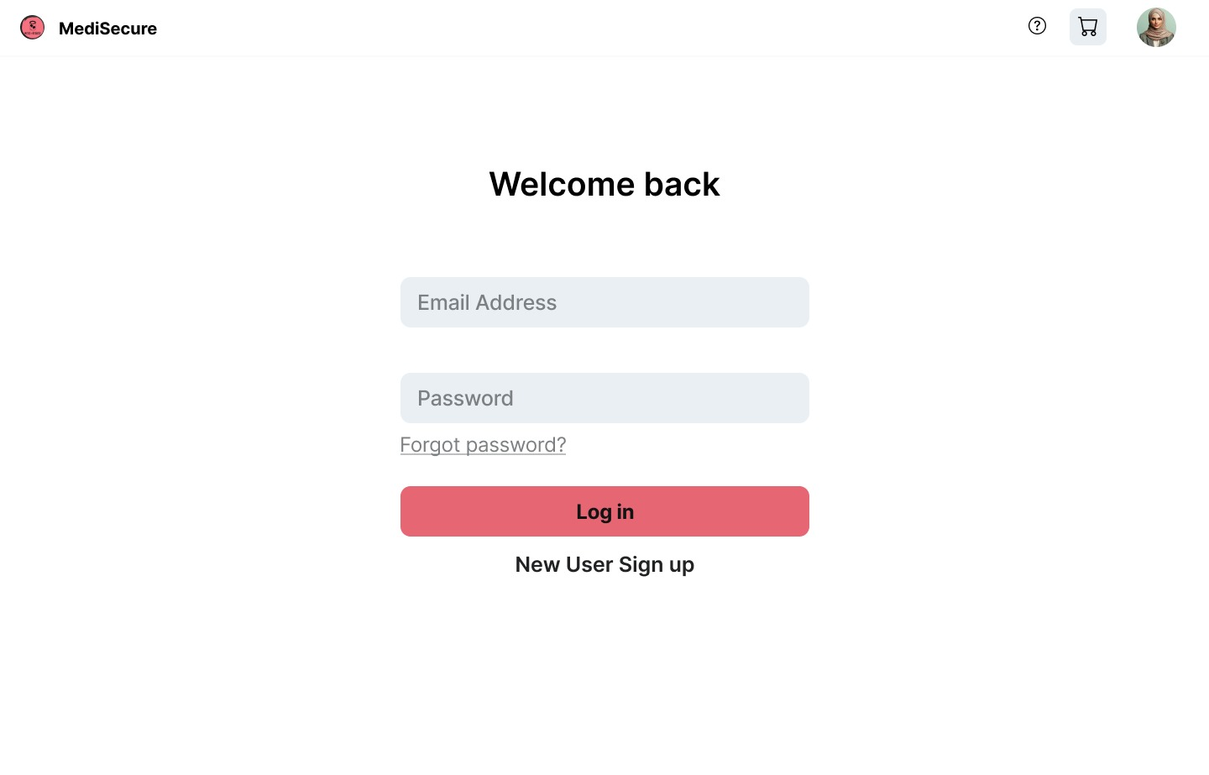
Website User Interface:

Slide 17
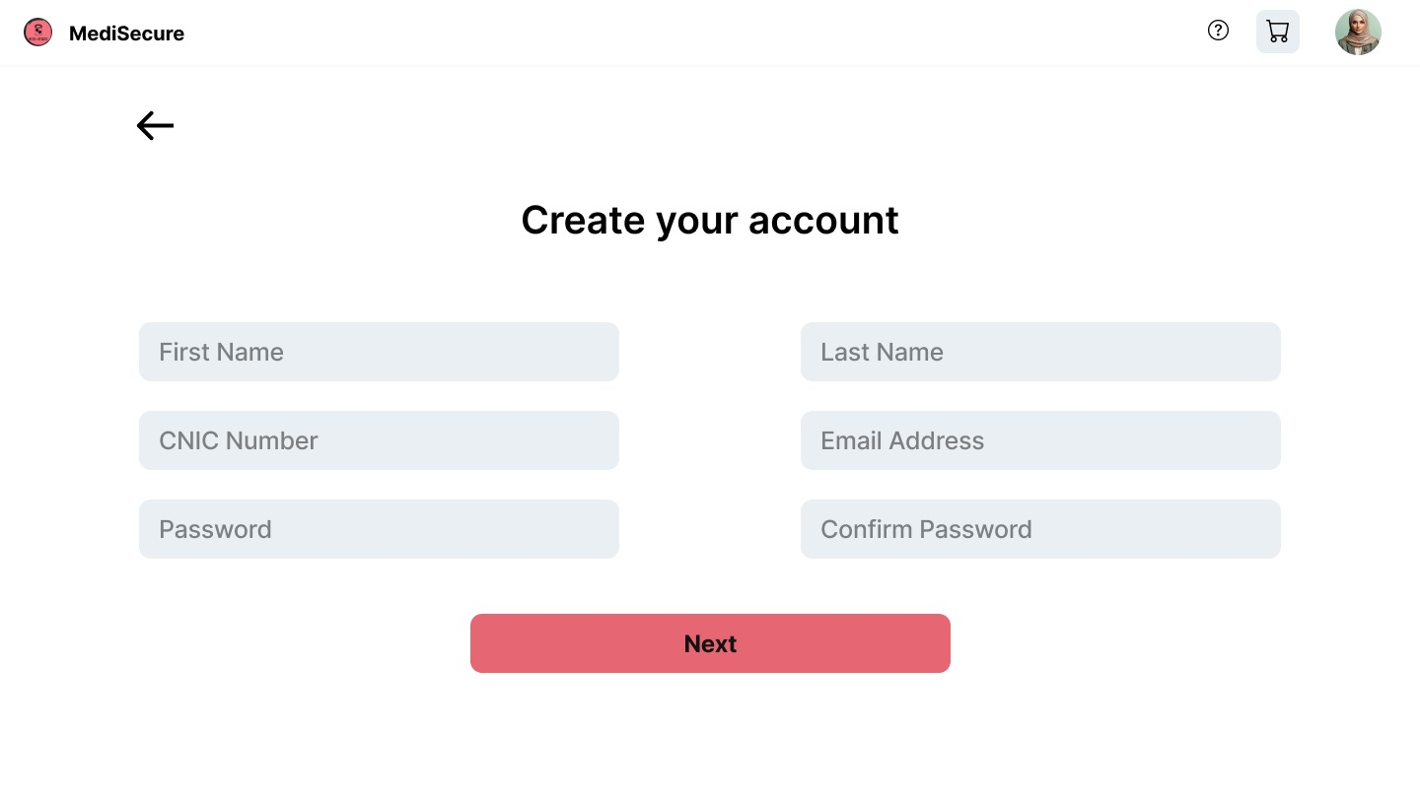
Website User Interface:

Slide 18
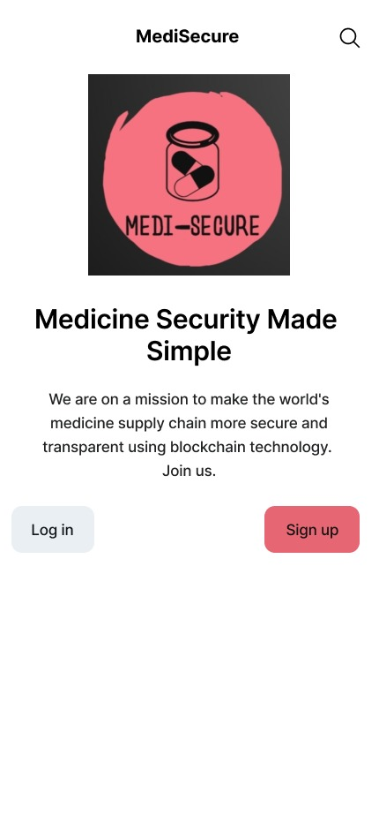
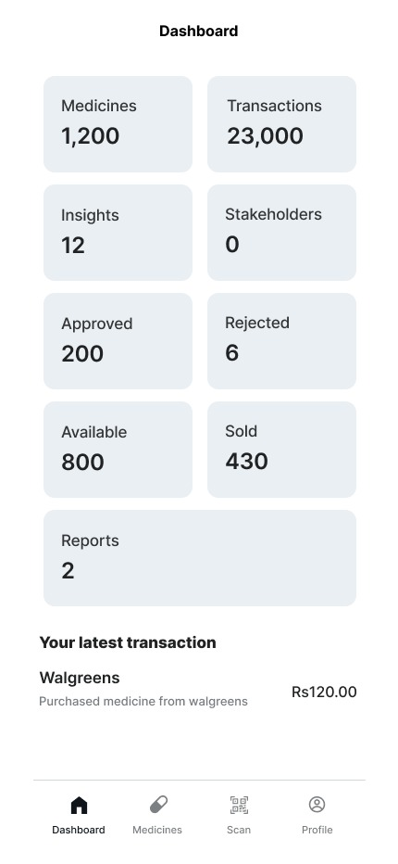
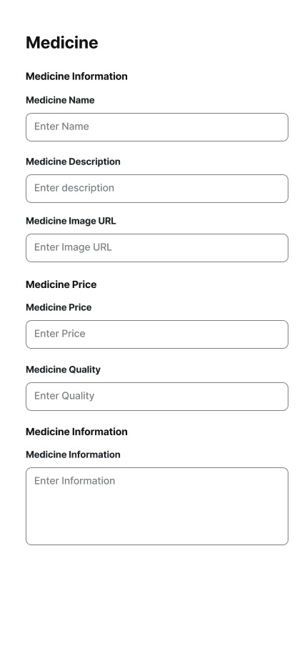
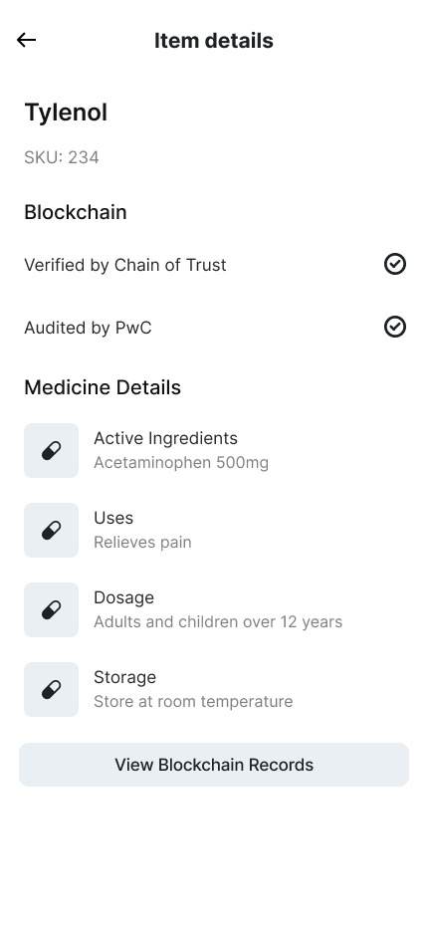
Mobile App User Interface

Slide 19
8- Reference
Radanović, Igor, and Robert Likić. 2018. “Opportunities for Use of Blockchain Technology in Medicine.” Applied Health Economics and Health Policy 16 (5): 583–90. https://doi.org/10.1007/s40258-018-0412-8
‌ Li, Hongyu, Liehuang Zhu, Meng Shen, Feng Gao, Xiaoling Tao, and Sheng Liu. 2018. “Blockchain-Based Data Preservation System for Medical Data.” Journal of Medical Systems 42 (8). https://doi.org/10.1007/s10916-018-0997-3
‌Chen, Yi, Shuai Ding, Zheng Xu, Handong Zheng, and Shanlin Yang. 2018. “Blockchain-Based Medical Records Secure Storage and Medical Service Framework.” Journal of Medical Systems 43 (1). https://doi.org/10.1007/s10916-018-1121-4
Chen, Yi, Shuai Ding, Zheng Xu, Handong Zheng, and Shanlin Yang. 2018. “Blockchain-Based Medical Records Secure Storage and Medical Service Framework.” Journal of Medical Systems 43 (1). https://doi.org/10.1007/s10916-018-1121-4

